Slide 1
Lecture 10: Floorplan – II
Tsung-Wei (TW) Huang
Department of Electrical and Computer Engineering
University of Utah, Salt Lake City, UT

Slide 2
Floorplanning
I/O Pads
Floorplan
Module a
Module b
Block a
Block c
Module c
Floorplanning
GND
VDD
Block d
Block Pins
Module d
Block b
Block e
Module e
Partitioned modules (e.g., FM algorithm)
Supply Network

Slide 3
Recap: Slicing Floorplan
Slicing floorplan
One that can be obtained by repetitively subdividing (slicing) rectangles horizontally or vertically
Non-slicing floorplan
One that may not be obtained by repetitively subdividing alone
Slicing floorplans are much easier to handle
Efficient data structures exist for efficient computational manipulations
Slicing Floorplan
Non-slicing Floorplan

Slide 4
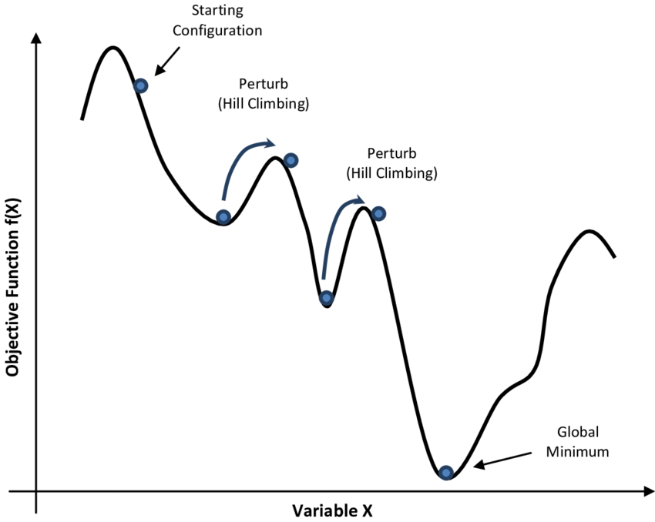
Simulated Annealing-based Optimization
1
Each move gives a new floorplan result
Key idea: Leverage simulated annealing to optimize moves
1
M1
2
4
5
5
3
4
3
2
34V2H5V1H
32V4H5V1H
M3
1
1
4
5
5
M2
3
2
3
2
4
32V45VH1H
32V45HV1H

Slide 5
Big Idea in Floorplan Optimization
Design efficient linear state representation for 2D layout
Polish expression (PE) for slicing floorplan
Apply SA to optimize state representation
Slicing Tree
V
Slicing Floorplan
3
H
H
1
2
1
H
3
4
5
V
V
2
6
7
6
7
4
5
21H67V45VH3HV

Slide 6
Sequence Pair
H. Murata, K. Fujiyoshi, S. Nakatake and Y. Kajitani, “VLSI module placement based on rectangle-packing by the sequence-pair,” in IEEE TCAD, vol. 15, no. 12, pp. 1518-1524, Dec. 1996
One of the most influential papers in the computer design industry
Widely used by industrial tools
Sequence pair is a succinct representation of non-slicing floorplan
Just like PE for slicing floorplan
Leverage SA to find a good sequence pair for floorplan optimization

Slide 7
Sequence Pair (cont’d)
Positive sequence: lower-left to upper-right, i.e., ecafdb
Negative sequence: upper-left to lower-right, i.e., fcbead
e
e
d
a
d
a
Positive
c
Negative
c
f
f
b
b

Slide 8
Sequence Construction
To go from a floorplan to its sequence pair, we first draw up-right steplines for each module as follows:
Starting from the upper right corner of a module until we reach the upper right corner of the floorplan, we draw vertical lines (going up) and horizontal lines (going right) in an alternative fashion so that we don’t cross any module boundary in the floorplan and any previously drawn line
We also draw down-left steplines in a similar way but in an opposite direction

Slide 9
Positive Sequence Construction
Positive stepline sequence: e
e
a
d
c
f
b

Slide 10
Positive Sequence Construction
Positive stepline sequence: ec
e
a
d
c
f
b

Slide 11
Positive Sequence Construction
Positive stepline sequence: eca
e
a
d
c
f
b

Slide 12
Positive Sequence Construction
Positive stepline sequence: ecaf
e
a
d
c
f
b

Slide 13
Positive Sequence Construction
Positive stepline sequence: ecafdb
e
a
d
c
f
b

Slide 14
Positive Sequence Construction
Positive stepline sequence: ecafdb
e
a
d
c
f
b

Slide 15
Negative Sequence Construction
Negative stepline sequence: f
e
a
d
c
f
b

Slide 16
Negative Sequence Construction
Negative stepline sequence: fc
e
a
d
c
f
b

Slide 17
Negative Sequence Construction
Negative stepline sequence: fcb
e
a
d
c
f
b

Slide 18
Negative Sequence Construction
Negative stepline sequence: fcbe
e
a
d
c
f
b

Slide 19
Negative Sequence Construction
Negative stepline sequence: fcbea
e
a
d
c
f
b

Slide 20
Negative Sequence Construction
Negative stepline sequence: fcbead
e
a
d
c
f
b

Slide 21
Sequence Pair Property
The authors showed that the positive/negative sequence of modules always exist and do not cross each other
e
e
d
a
d
a
ecafdb
c
c
fcbead
f
f
b
b

Slide 22
Geometric Info of a Sequence Pair
Given a sequence pair (P, N)
a is right to b, iff a is after b in both P and N
a is left to b, iff a is before b in both P and N
a is above b, iff a is before b in P and a is after b in N
a is below b, iff a is after b in P and a is before b in N
c is above f
a is right to c
b is below to e
…

Slide 23
Solution Perturbation
M1: swap a random pair of modules in the first sequence
(ecafdb, fcbead) → (eacfdb, fcbead)
M2: swap a random pair of modules in both sequences
(ecafdb, fcbead) → (edafcb, fdbeac)
M3: rotate a randomly selected module
(ecafdb, fcbead), (W_{c}, H_{c}) → (ecafdb, fcbead), (H_{c}, W_{c})
How do we recover the floorplan of a sequence pair?

Slide 24
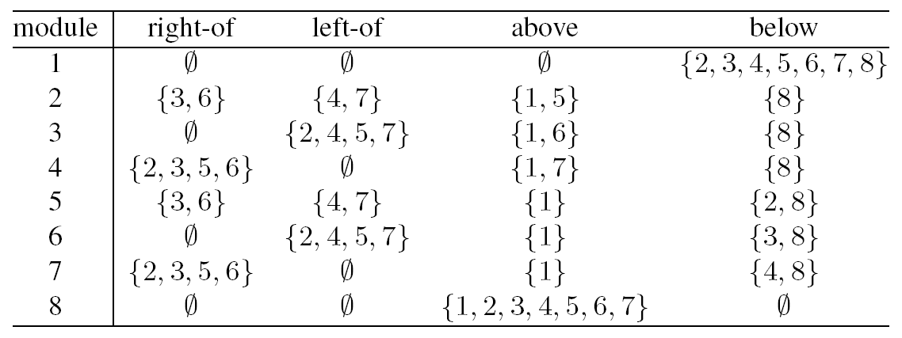
Find Relative Locations Among Modules
SP = (17452638, 84725361)
Dimensions (W, H): (2,4), (1,3), (3,3), (3,5), (3,2), (5,3), (1,2), (2,4)

Slide 25
Module Locations on a Grid
Rotate 45 degree

Slide 26
Module Locations on a Grid
Positive sequence
(17432638)
1
1
7
6
4
3
5
5
2
2
6
7
Negative sequence
(84725361)
3
4
8
8

Slide 27
Module Locations on a Grid
1
Positive sequence
(17432638)
7
5
6
1
1
4
2
3
7
6
4
3
5
5
2
2
6
7
Negative sequence
(84725361)
3
8
4
8
8

Slide 28
Horizontal Constraint Graph (HCG)
Add a directed edge m1→m2 iff m2 is to the left of module m1

Slide 29
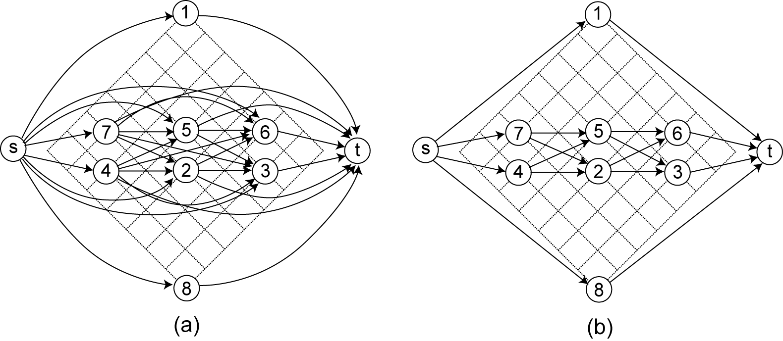
Horizontal Constraint Graph (cont’d)
Transitive reduction

Slide 30
Vertical Constraint Graph (VCG)
Add a directed edge m1→m2 iff m2 is above module m1

Slide 31
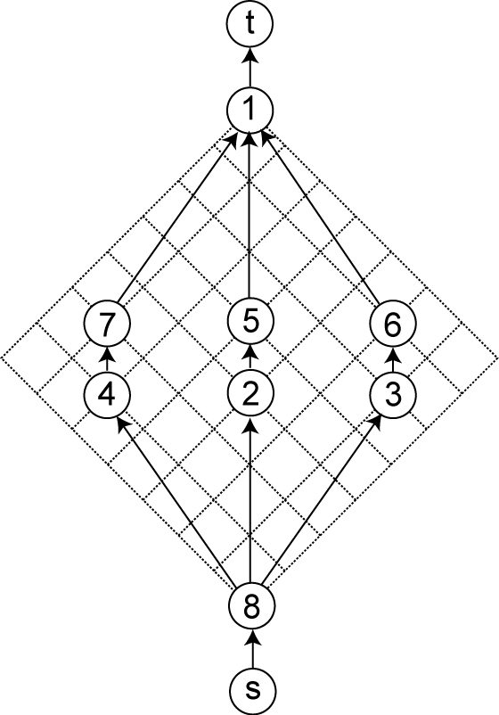
Vertical Constraint Graph (cont’d)

Slide 32
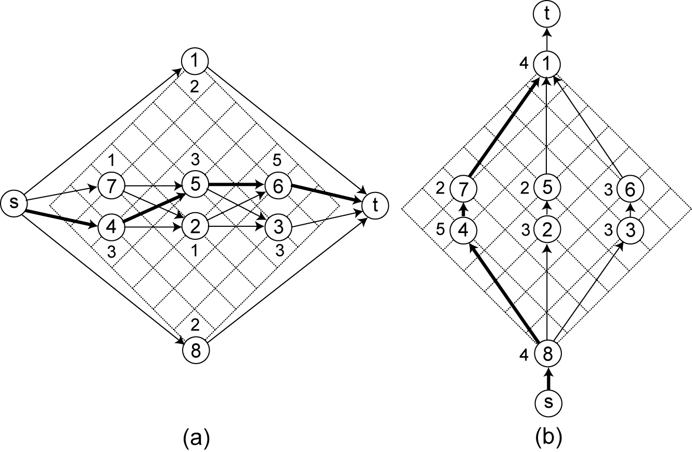
Computing Floorplan Width and Height
Longest s-t path in
HCG: chip width
VCG: chip height
Node weight = module width/height!

Slide 33
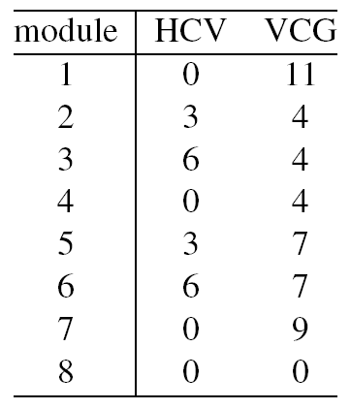
Computing Module Locations
Lower-left corner location maps to s-t longest path
Longest path to each module

Slide 34
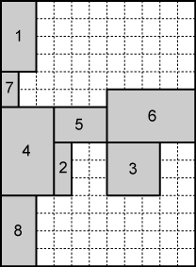
Floorplan Result
11×15

Slide 35
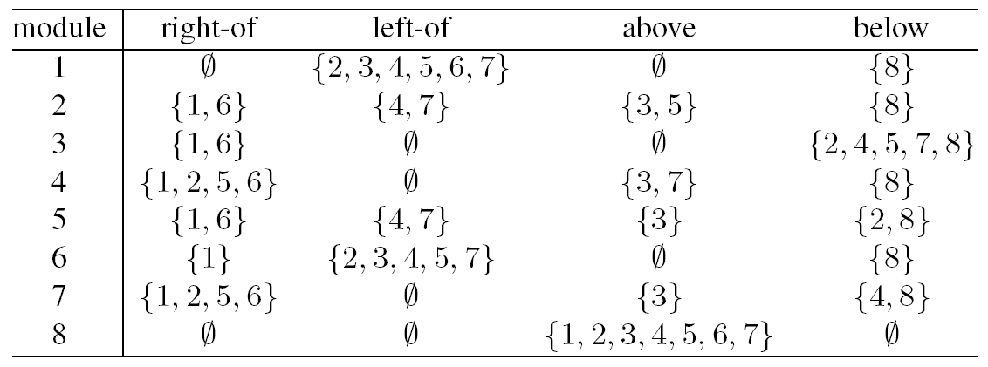
Move 1
Swap 1 and 3 in positive sequence of SP₁
SP₁ = (17452638, 84725361); SP₂ = (37452618, 84725361)

Slide 36
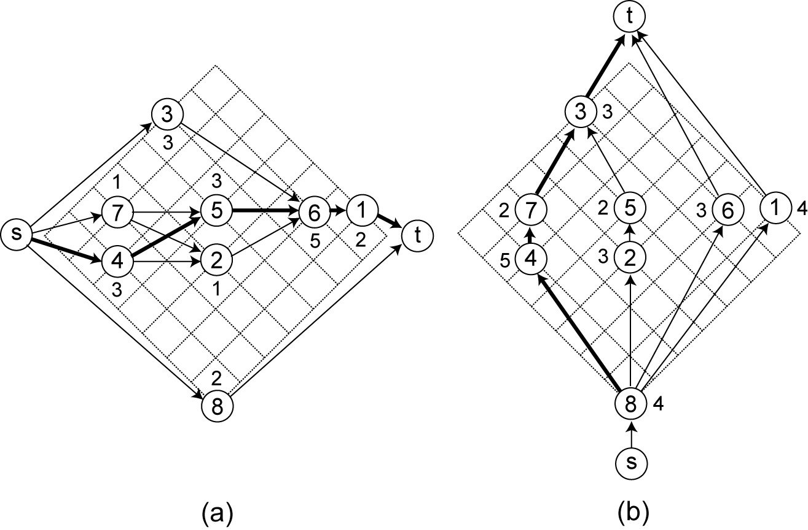
Constraint Graphs after Move 1

Slide 37
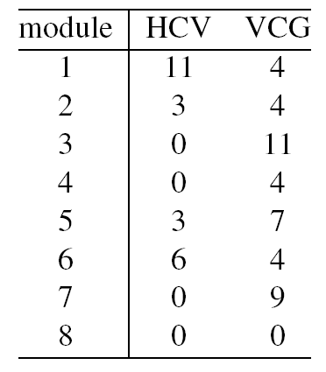
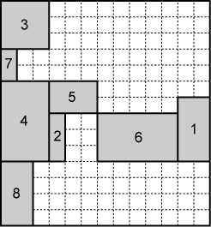
Constructing Floorplan after Move 1
13×14

Slide 38
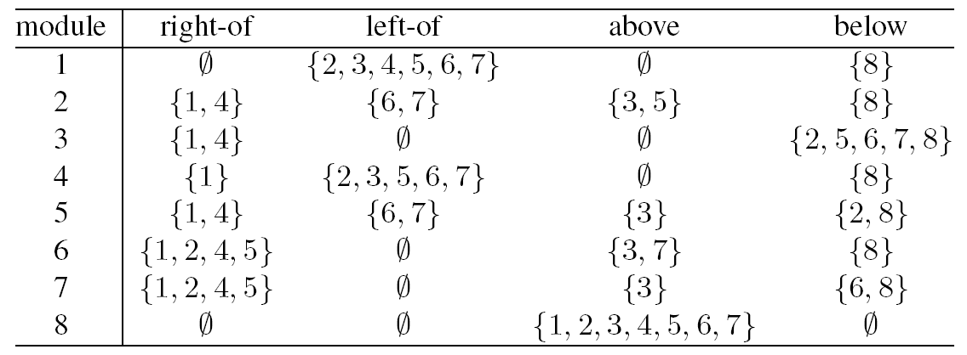
Move 2
Swap 4 and 6 in both sequences of SP₂
SP₂ = (37452618, 84725361); SP₃ = (37652418, 86725341)

Slide 39
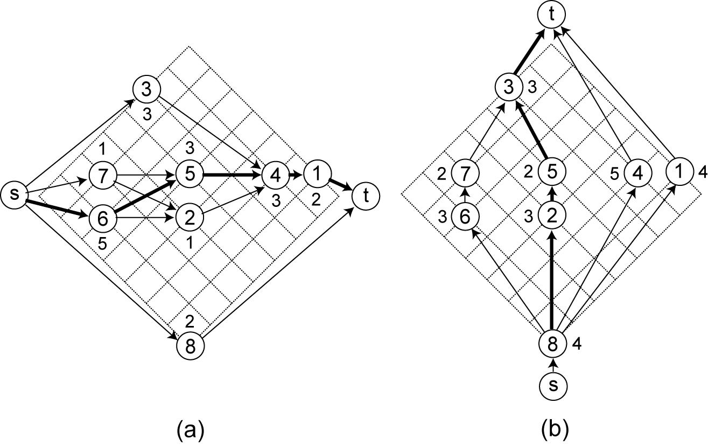
Constraint Graphs after Move 2

Slide 40
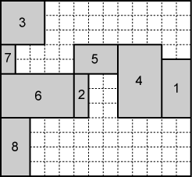
Constructing Floorplan after Move 2
13×12

Slide 41
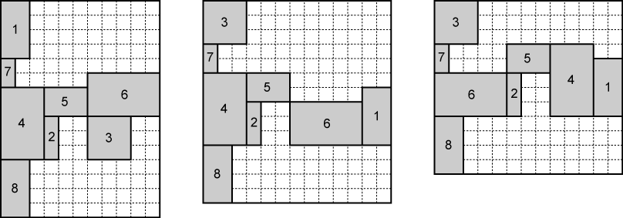
Impacts of Move 1 and Move 2
Floorplan dimension changes from 11×15 to 13×14 to 13×12

Slide 42
Summary
We have discussed sequence pair floorplan optimization
Positive and negative sequences to describe module locations
Can represent generic floorplan (non-slicing layout)
We have discussed floorplan recovery from sequence pair
Horizontal constraint graph (HCG)
Vertical constraint graph (VCG)
Longest path in HCG represents the floorplan width
Longest path in VCG represents the floorplan height

